Slide 1
Kubernetes
Shalini Mittal
Corporate Trainer
Notes:
minikube start

Slide 2
What is Kubernetes
Kubernetes, also known as K8s, is an open-source system for automating deployment, scaling, and management of containerized applications.
It groups containers that make up an application into logical units for easy management and discovery
Kubernetes is an extensible, portable, and open-source platform designed by Google in 2014.
Mainly used to automate the deployment, scaling, and operations of the container-based applications across the cluster of nodes.
Written on Golang, it has a huge community because it was first developed by Google & later donated to CNCF
Many cloud services offer a Kubernetes-based infrastructure on which it can be deployed as the platform-providing service.
This technique or concept works with many container tools, like docker, and follows the client-server architecture.

Slide 3
Before Kubernetes
Handling a large number of containers all together was also a problem. Sometimes while running containers, on the product side, few issues were raised, which were not present at the development stage.
This kind of scenarios introduced the Container Orchestration System.
Notes:
https://www.edureka.co/blog/kubernetes-tutorial/

Slide 4
Containerization Engine
To avoid setting up services manually & overcome the challenges, something big was needed. This is where Container Orchestration Engine comes into the picture.
This engine, lets us organize multiple containers, in such a way that all the underlying machines are launched, containers are healthy and distributed in a clustered environment.
In today’s world, there are mainly two such engines: Kubernetes & Docker Swarm
Notes:
AWS services are region scoped, hence a service in 1 region is not available in other region

Slide 5
Kubernetes vs Docker Swarm

Slide 6
Kubernetes Features
Notes:
https://www.edureka.co/blog/what-is-kubernetes-container-orchestration

Slide 7
Kubernetes Components
Kubernetes Architecture has the following main components:
Master nodes Responsible for the management of Kubernetes cluster. It is mainly the entry point for all administrative tasks. There can be more than one master node in the cluster to check for fault tolerance.
Worker/Slave nodes Worker nodes contain all the necessary services to manage the networking between the containers, communicate with the master node, and assign resources to the scheduled containers
Distributed key-value store(etcd.) simple, distributed, consistent key-value store. It’s mainly used for shared configuration and service discovery.

Slide 8
Master Node
Notes:
https://www.edureka.co/blog/kubernetes-architecture/

Slide 9
Master Node
It is the entry point for all administrative tasks which is responsible for managing the Kubernetes cluster.
There can be more than one master node in the cluster to check for fault tolerance.
More than one master node puts the system in a High Availability mode, in which one of them will be the main node which we perform all the tasks.
For managing the cluster state, it uses etcd in which all the master nodes connect to it.
discovery.

Slide 10
Master Node Components
The master node has various components like
API Server
Controller Manager
Scheduler
ETCD.

Slide 11
API Server
API Server: The API server is the entry point for all the REST commands used to control the cluster. Performs all the administrative tasks through the API server within the master node. In this REST commands are sent to the API server which validates and processes the requests. After requesting, the resulting state of the cluster is stored in the distributed key-value store.

Slide 12
Scheduler
Scheduler: The scheduler schedules the tasks to slave nodes. It stores the resource usage information for each slave node. It schedules the work in the form of Pods and Services. Before scheduling the task, the scheduler also takes into account the quality of the service requirements, data locality, affinity, anti-affinity, etc.

Slide 13
Controller
Controller Manager: Also known as controllers.
It is a daemon which regulates the Kubernetes cluster which manages the different non-terminating control loops.
It also performs lifecycle functions such as namespace creation and lifecycle, event garbage collection, terminated-pod garbage collection, cascading-deletion garbage collection, node garbage collection, etc.
Basically, a controller watches the desired state of the objects it manages and watches their current state through the API server.
If the current state of the objects it manages does not meet the desired state, then the control loop takes corrective steps to make sure that the current state is the same as the desired state.

Slide 14
ETCD
ETCD: ETCD is a simple, distributed, consistent key-value store. It’s mainly used for shared configuration and service discovery.
It can be part of the Kubernetes Master, or, it can be configured externally.
etcd is written in the Go programming language. In Kubernetes, besides storing the cluster state (based on the Raft Consensus Algorithm) it is also used to store configuration details such as subnets, ConfigMaps, Secrets, etc.
A raft is a consensus algorithm designed as an alternative to Paxos. The Consensus problem involves multiple servers agreeing on values; a common problem that arises in the context of replicated state machines. Raft defines three different roles (Leader, Follower, and Candidate) and achieves consensus via an elected leader

Slide 15
Worker Node
A physical server or you can say a VM which runs the applications using Pods (a pod scheduling unit) which is controlled by the master node.
On a physical server (worker/slave node), pods are scheduled. For accessing the applications from the external world, we connect to nodes.

Slide 16
Worker Node Components
Container runtime
Kubelet
Kube-proxy
Pods

Slide 17
Container Runtime
To run and manage a container’s lifecycle, we need a container runtime on the worker node.
Sometimes, Docker is also referred to as a container runtime, but to be precise, Docker is a platform which uses containers as a container runtime.
Kubernetes supports several container runtimes: Docker, containerd, CRI-O, and any implementation of the Kubernetes CRI (Container Runtime Interface).

Slide 18
Kubelet
It is an agent which communicates with the Master node and executes on nodes or the worker nodes.
It gets the Pod specifications through the API server and executes the containers associated with the Pod and ensures that the containers described in those Pod are running and healthy.
The kubelet doesn't manage containers which were not created by Kubernetes.

Slide 19
Kube-proxy
Kube-proxy runs on each node to deal with individual host sub-netting and ensure that the services are available to external parties.
It serves as a network proxy and a load balancer for a service on a single worker node and manages the network routing for TCP and UDP packets.
It is the network proxy which runs on each worker node and listens to the API server for each Service endpoint creation/deletion.
For each Service endpoint, kube-proxy sets up the routes so that it can reach to it.

Slide 20
Pods
Pods are the smallest deployable units of computing that you can create and manage in Kubernetes.
A pod is one or more containers that logically go together.
Pods run on nodes.
Pods run together as a logical unit.
So they have the same shared content.
They all share the same IP address but can reach other Pods via localhost, as well as shared storage.
Pods don’t need to all run on the same machine as containers can span more than one machine.
One node can run multiple pods.
https://kubernetes.io/docs/concepts/workloads/pods/

Slide 21
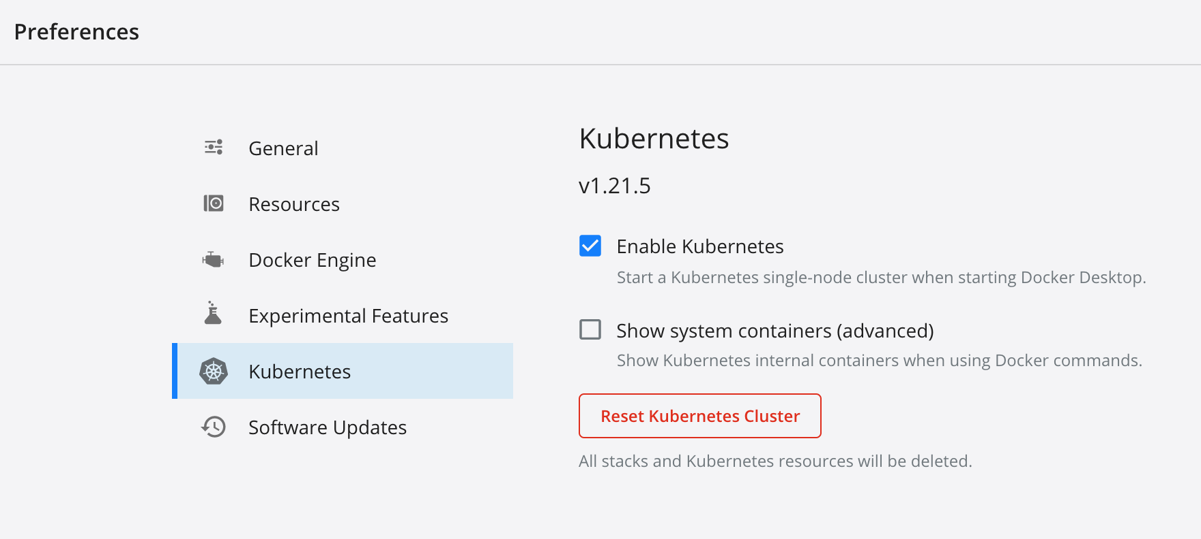
Kubernetes With Docker Desktop
Enable kubernetes on docker desktop preferences

Slide 22
Kubernetes Commands
kubectl version
kubectl get nodes
docker container ls
docker info
kubectl get pods
kubectl get pods --all-namespaces
kubectl get namespaces
kubectl get all
Kubectl get services

Slide 23
Kubernetes Cluster
Create a yaml file
kubectl apply -f Deploy.yaml
kubectl get pods -o wide -o wide are used to know on which node is the deployment running
After you have created a deployment, now you have to create a service. For that again use an editor and open a blank service.yaml file
After you write your service file, apply the service file using the following command. kubectl apply -f service.yaml
kubectl describe svc netsvc

Slide 24
References
https://kubernetes.io/docs/concepts/overview/components/
https://www.edureka.co/blog/kubernetes-architecture/
https://www.edureka.co/blog/kubernetes-tutorial/
https://www.bmc.com/blogs/it-orchestration-vs-automation-whats-the-difference/
https://www.edureka.co/blog/amazon-eks/
https://birthday.play-with-docker.com/kubernetes-docker-desktop/
https://www.section.io/engineering-education/deploy-docker-container-to-kubernetes-cluster/

Slide 25

Any Question ?

Slide 26


7738460004 shalini06mittal@gmail.com
Thank you !

